Slide 1


THE PROBLEM
WHAT
Choosing the right GPU is challenging — each comes with varying prices, specifications, and availability.
WHY
Too many GPU options. Specs, costs, and regions vary.
Users don’t know which GPU fits their AI/ML workload.
Manual selection wastes time and money.
No tool provides smart, budget-aware recommendations.

Slide 2


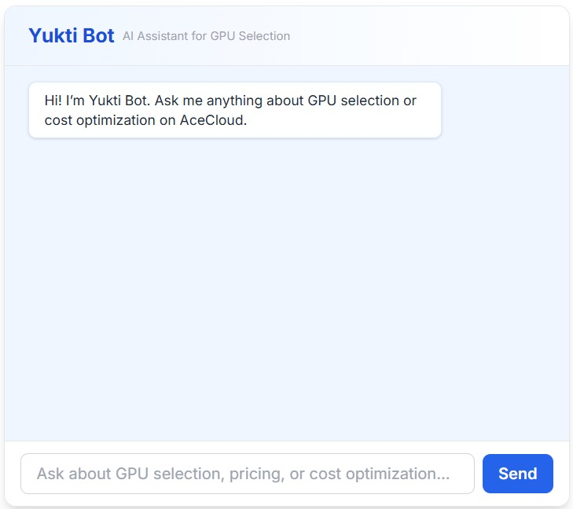

CloudYukti -----A Smart GPU Instance Recommender for AceCloud----
Please click the below icons for hyperlink access
Team Name- SD-013
Ansh Jain
Abhinav Gupta
Akshat Goel

Slide 3


Solution Overview
 | Developed a full-stack web app “CloudYukti” where users input key details of their AI/ML workloads—such as model type, task (training/inference), dataset size, region, and budget..
 | The backend system connects to AceCloud’s public API to fetch real-time data about available GPU instances, including specs, pricing (on-demand and spot), and availability.
 | CloudYukti uses rule-based recommendation engine that leverages a curated knowledge base of GPU capabilities. It matches user workloads to the most suitable GPU types based on factors like memory, compute power, and task fit. Engine applies filters based on region, budget constraints, and availability to ensure only relevant instances are considered.
 | The system then calculates and compares cost estimates (hourly, monthly, spot vs. on-demand) and recommends the most cost-effective and performance-appropriate GPU instance.
 | In addition, the system integrates a chatbot feature that helps guide users through the process by answering queries, offering personalized recommendations based on the inputted workload, and providing real-time assistance on selecting the best GPU options.
 | Final recommendations are displayed in a clear, interactive frontend, along with the reasoning behind each suggestion and an option to request unavailable instances.

Slide 4

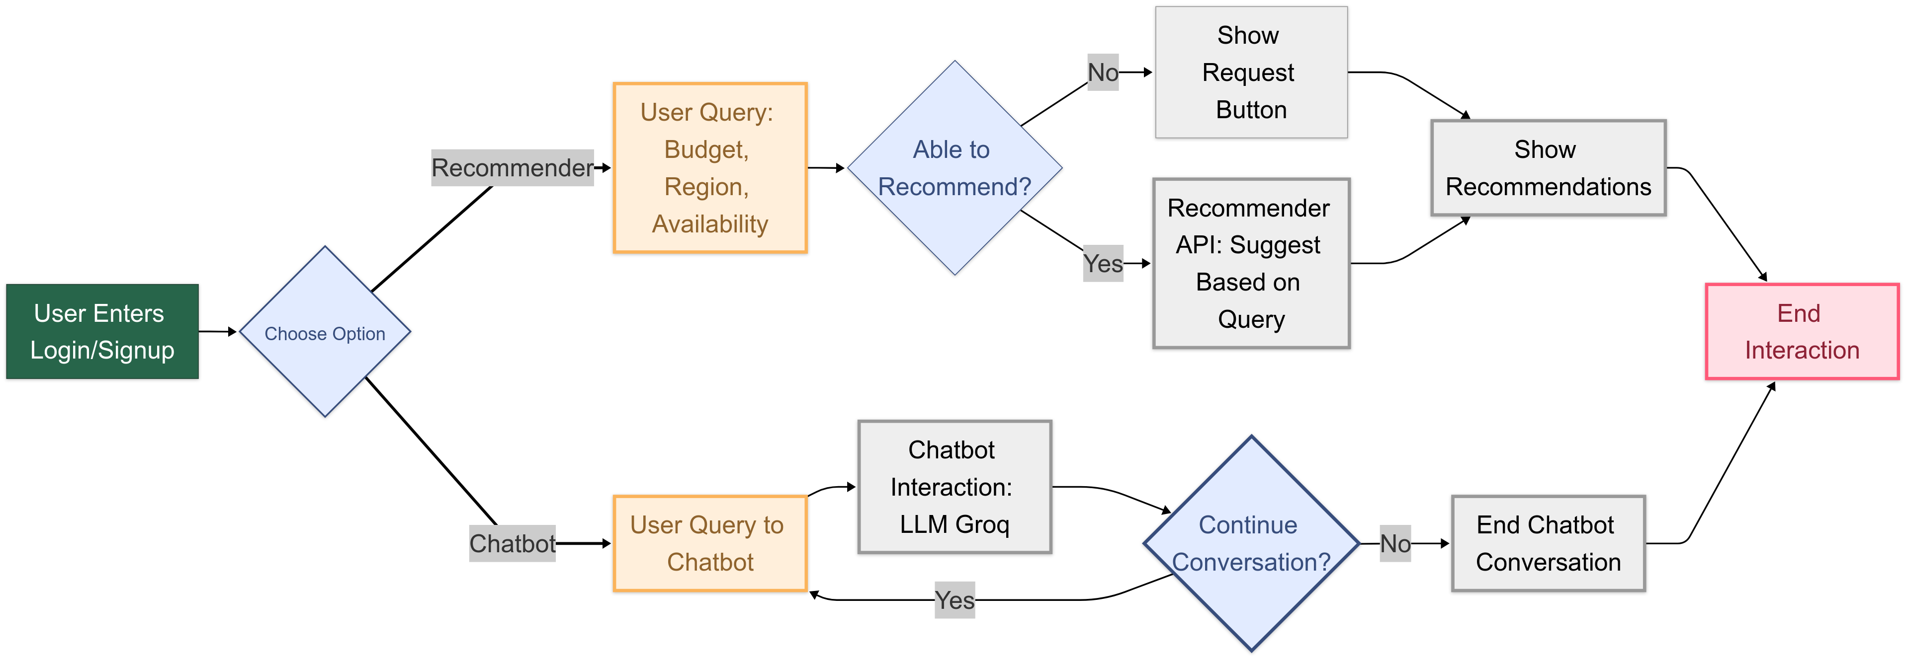


FLOW CHART

Slide 5
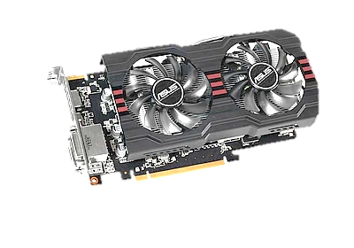





TECH-STACK
Next.js
Handles user authentication (login/signup), user dashboards, input forms, and displaying results.
Tailwind CSS
A utility-first CSS framework used to create modern, responsive layouts.
MongoDB
A NoSQL document-based database. Stores user credentials, input preferences, and interaction logs.
FastAPI
LLM (Groq)
Receives and interprets user queries related to GPU recommendations.
Acts as the backend API layer connecting the frontend (Next.js) with the LLM (Grok) and the database.

Slide 6


Business Model
Target Users
Revenue Channels
AceCloud Benefits
Freemium model
Basic recommendation = Free
Pro features (AI assistant, priority support, usage tracking) = Subscription
Increased GPU utilization
Higher customer satisfaction
Reduced support load
Data scientists
ML engineers
startups
enterprise cloud users

